Slide 1
What's new in .NET MAUI for Desktop App Development

Slide 2
.NET MAUI for .NET 7 General Availability
Foldable (*. AndroidX.Window)
Window Positioning
Tool Tips
Context Menus
Accessibility Improvements
PointerGestureRecognizer
PointerOver VSM
TapGestureRecognizer improvements
Position Data
Secondary

Slide 3
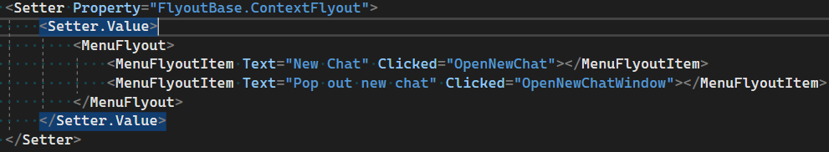
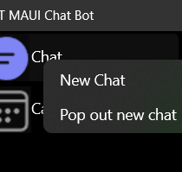
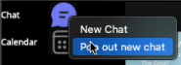
Context Menus
Are attached to a single element and display secondary commands.
Are invoked by secondary clicking (or an equivalent action, such as pressing and holding with your finger).
Are associated with an element via its FlyoutBase.ContextFlyout property.

Slide 4
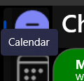
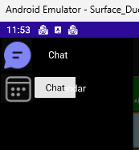
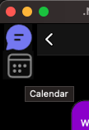
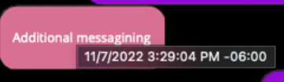
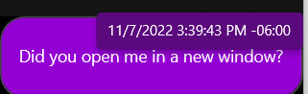
Tool Tips
A tooltip is a popup that contains additional information about another control or object.
Tooltips display automatically when the user moves focus to, presses and holds, or hovers the pointer over the associated control.
The tooltip disappears when the user moves focus from, stops pressing on, or stops hovering the pointer over the associated control (unless the pointer is moving towards the tooltip).

Slide 5
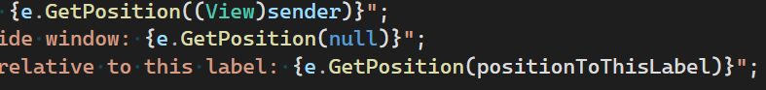
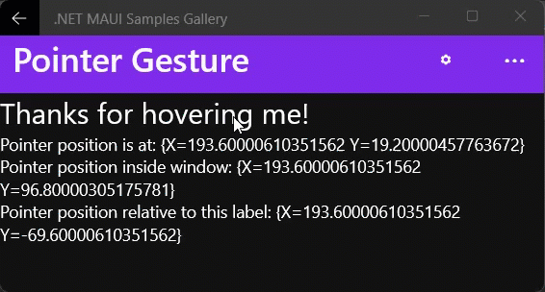
Pointer Gesture Recognizer
PointerEntered
PointerExited
PointerMoved
Pointer Position Data
Window Relative
View Relative

Slide 6
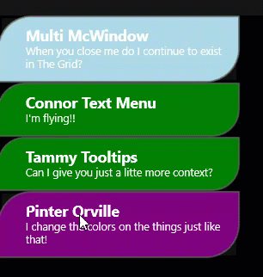
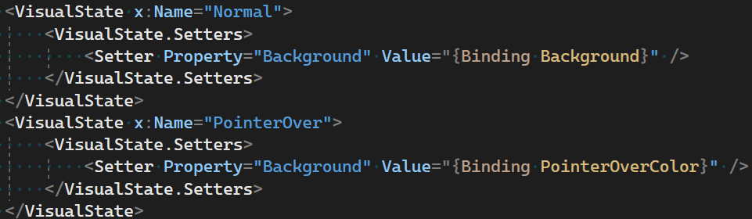
PointerOver VisualState

Slide 7
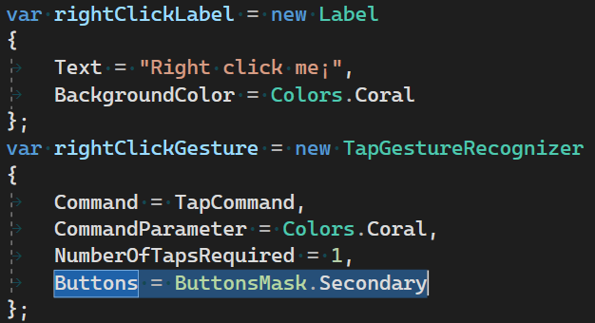
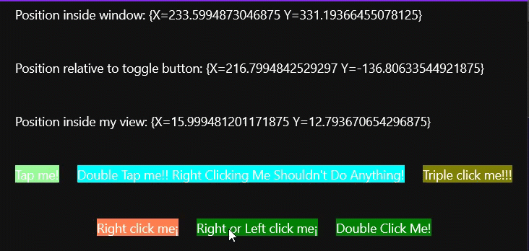
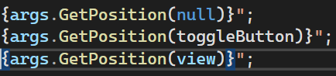
Tap Gesture Recognizer Improvements
Buttons Mask
TappedEventArgs

Slide 8
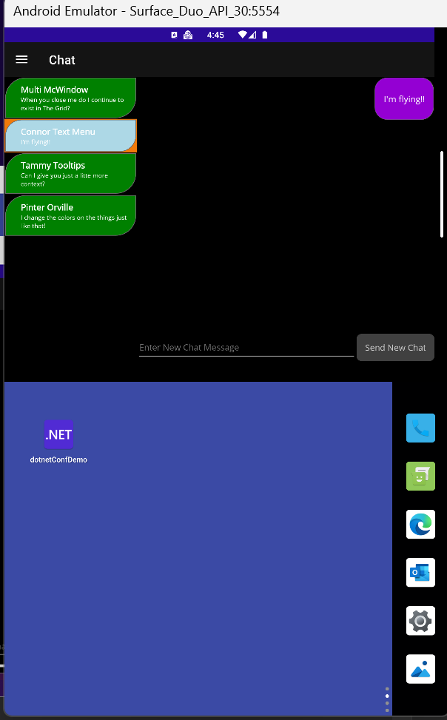
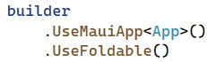
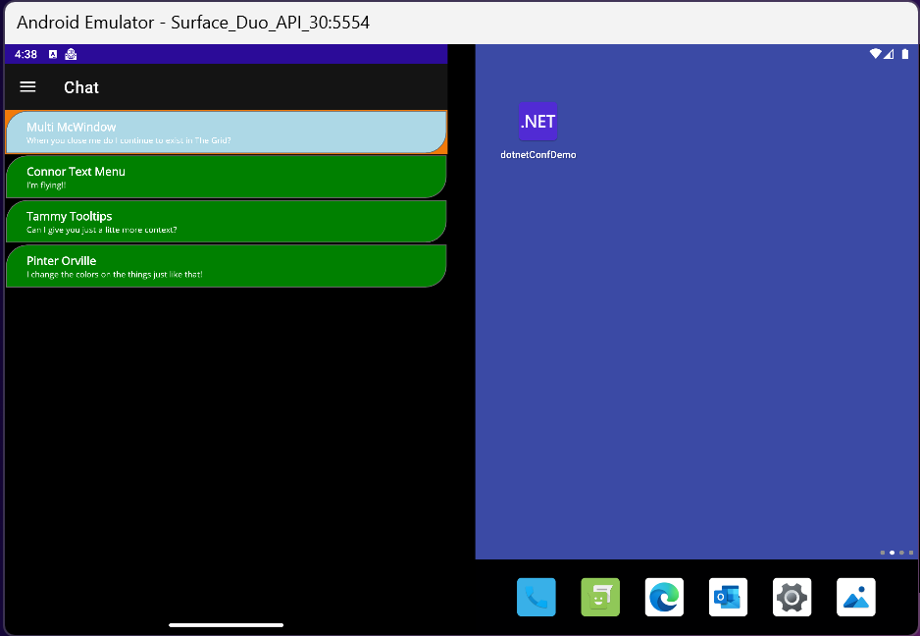
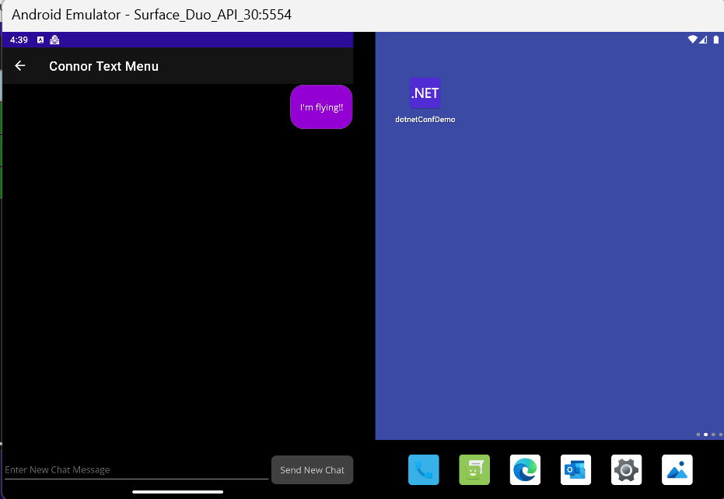
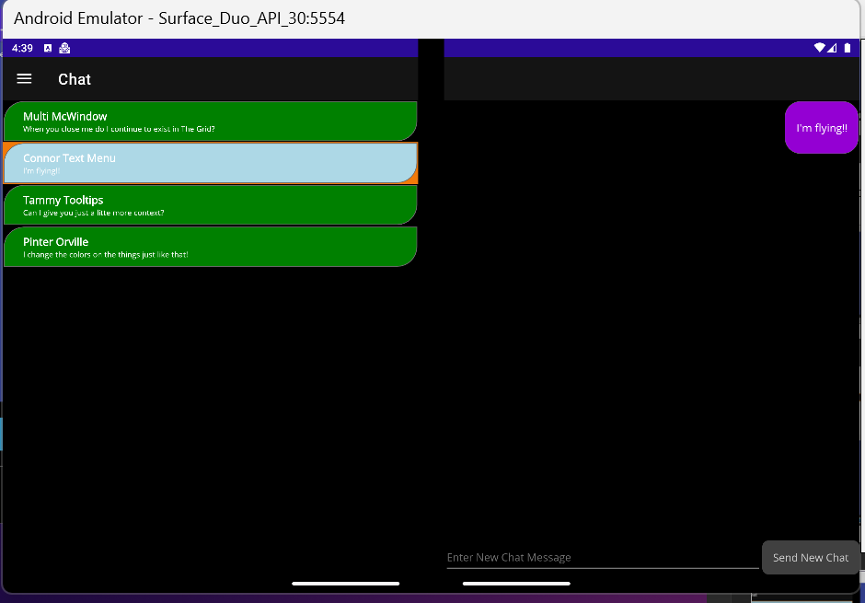
Foldable Support (*. AndroidX.Window)

Slide 9
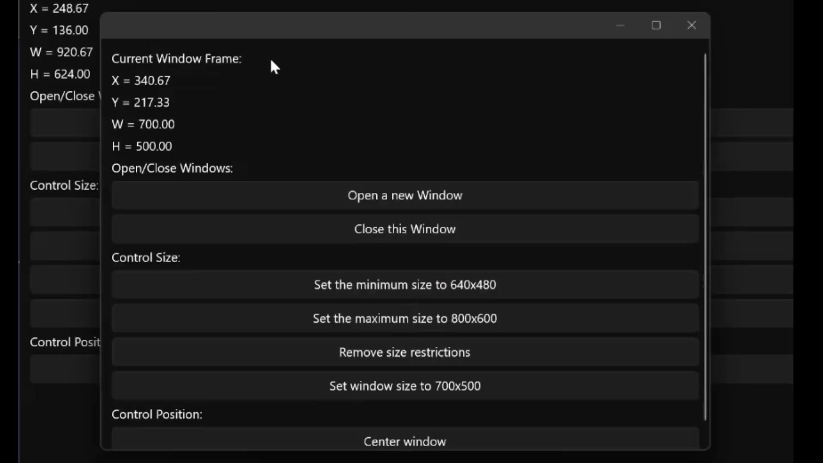
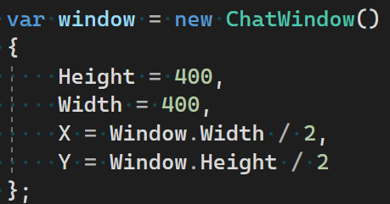
Window Position/Location APIs

Slide 10
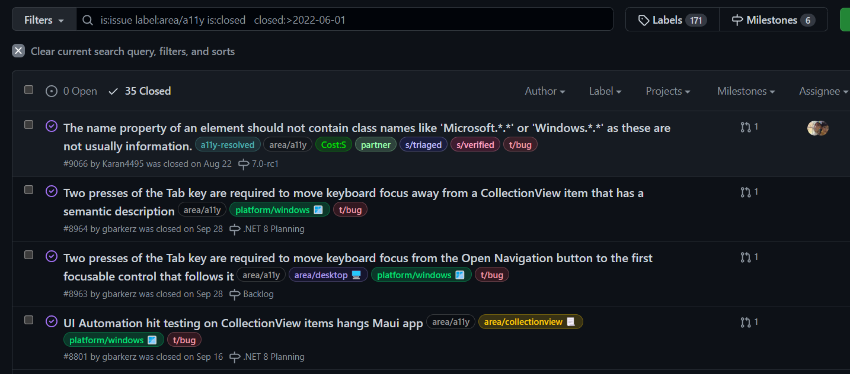
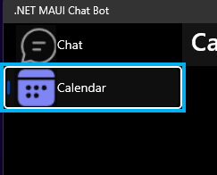
Accessibility Updates
Closed around 35 accessibility bugs in the last period.
Heavy focus on Windows Desktop experience
Accessibility Validation
“Calendar.
2 of 2 level 1.
Selected.”

Slide 11
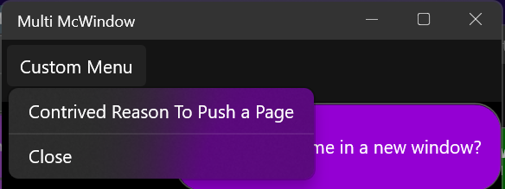
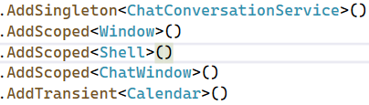
Honorable Mention Desktop and Multi-Window Features
MenuBar
MenuFlyoutSeparator (new)
Scoped Services

Slide 12
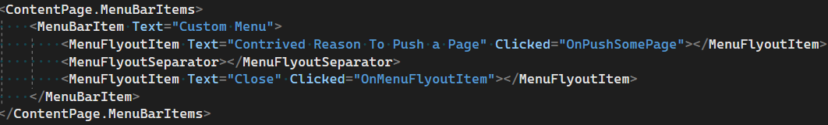
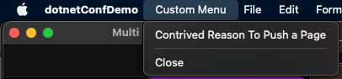
MenuBar

Slide 13
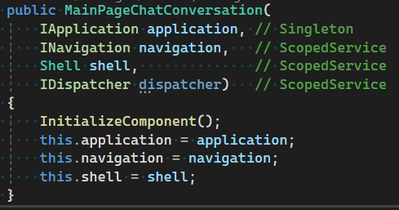



Scoped Services with MS.EXT.DI
AddSingleton
Scoped to app level
AddScoped
Scoped to Window
AddTransient
Single Use Types

Slide 14
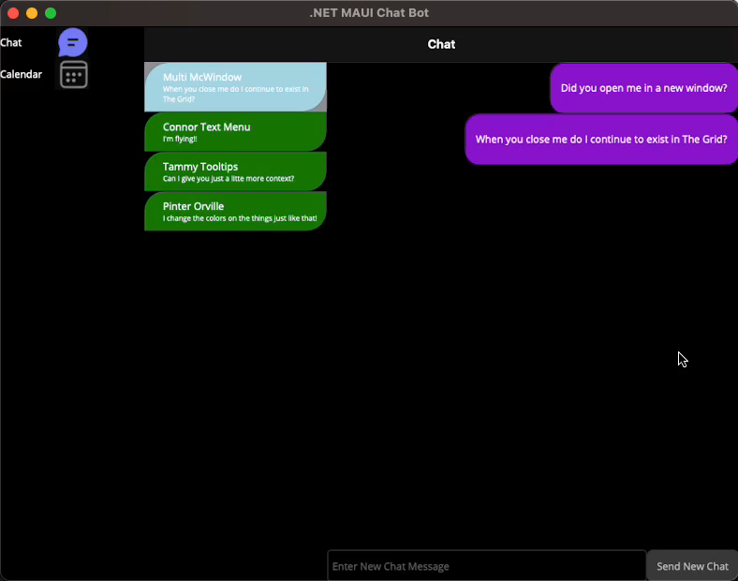
Demo

Slide 15
Additional Notes
Visual Studio for Mac 17.4 is now GA
Catalyst development experience!!
Reach me @PureWeen with questions
Download 17.5 stable now
Announcing .NET MAUI for .NET 7 General Availability - .NET Blog (microsoft.com)
PureWeen/dotnetConfDemo2022 (github.com)

